Slide 2
Automating the boring stuff
The Platform Services team

Slide 3

Who am I?
Rising Junior @ James Madison University
Computer Science Major
Guitar Player
Vim > emacs
Spaces > tabs

Slide 4

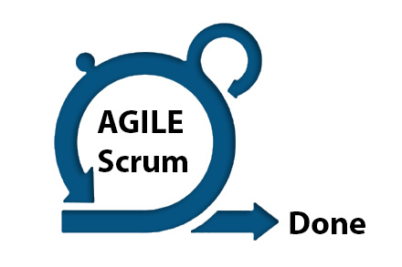
Working as a part of the team
In lieu of a formal project
Real hands-on experience with team
Agile development, working with Jira and daily standups

Slide 5
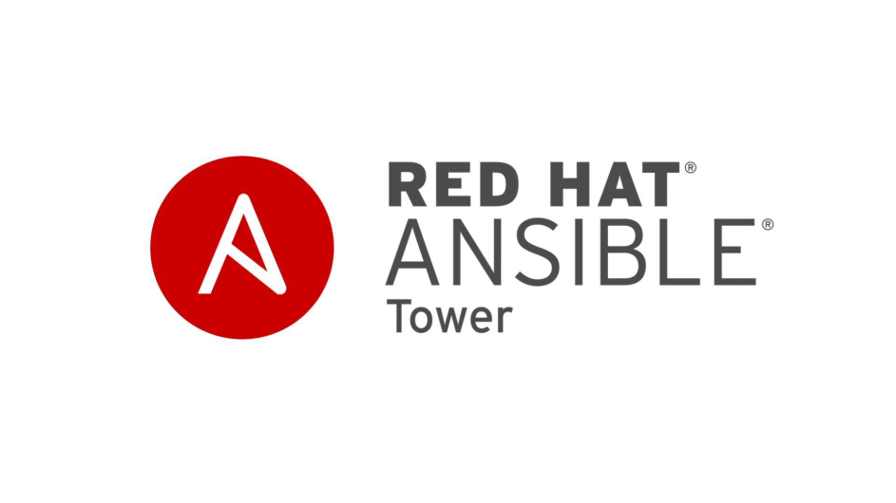

Ansible + Tower
Pre-Ansible at SWIFT, lengthy Installation and Configuration Guides were the only way to set up a new system
Simplifies and speeds up installations and configurations on multiple hosts at once
Manages Virtual Machines running at SWIFT
Ansible tower is the enterprise-level tool for managing Ansible scripts and hosts

Slide 6
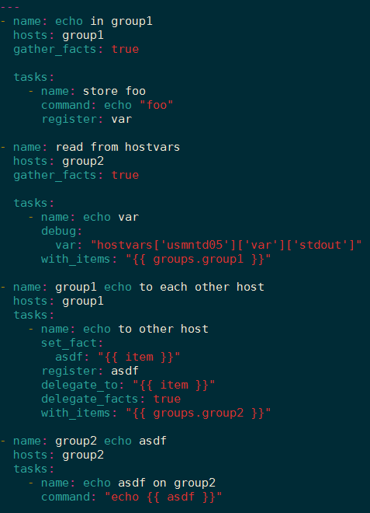

Slide 7
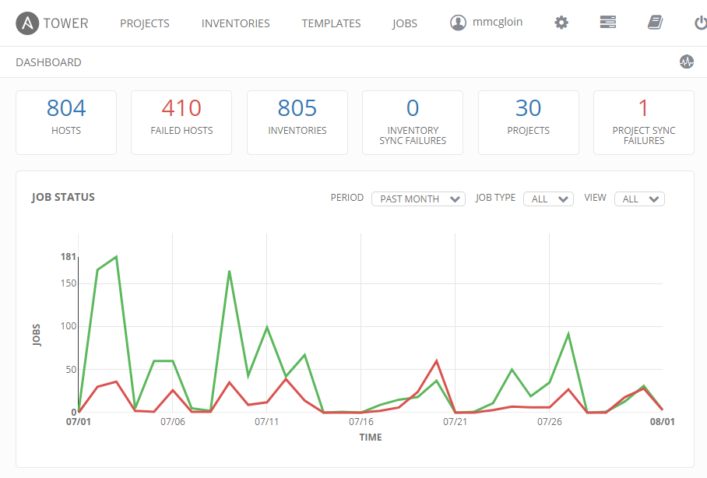
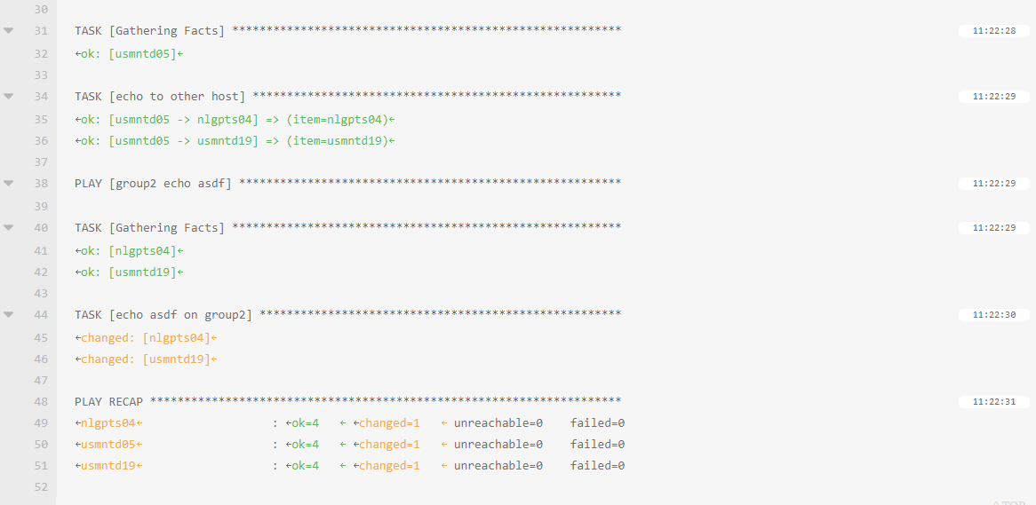
My Role in Ansible
Integrating with the team
Assisting with upgrading the Ansible playbooks a workflow-based solution to a job-template based one
Prototyping Ansible features to improve our code
Documenting current Ansible playbooks

Slide 8



pcdb
Automates application configuration, integrated with Ansible
Currently in initial development stages
Parses input yaml/json files to set up only what is needed on VM
Prototyping a python-based solution
Working to a unified set of requirements for PCDB input

Slide 9
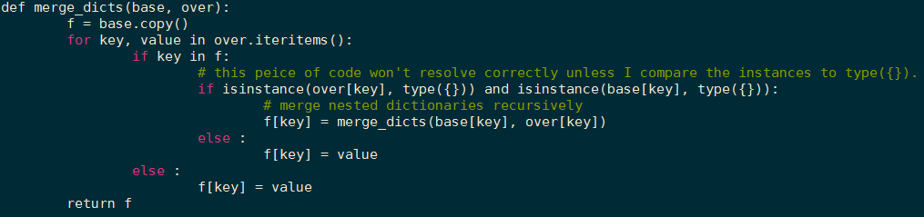
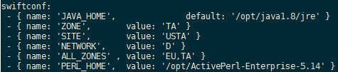
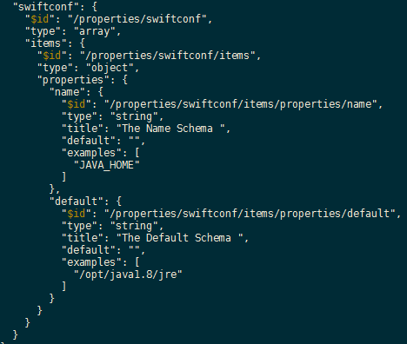

Slide 10
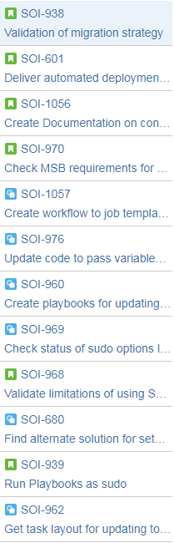
Business value added
Acting as a fresh set of eyes on code in use at swift
Fast turnaround on prototypes
Assisting in redesigning playbooks to ensure compatibility with future Ansible updates and security extensions
Helping to research Ansible’s best practices for future use
Updating and documenting old code

Slide 11
What I learned
Joining a project post-release
Catch-up required to become useful on team
Real-world SCRUM practices
More Ansible than I ever thought I would
Working and communicating on a real team
Helping and getting help from others
Approval process to get software working on SWIFT’s network

Slide 12
Questions?

